Slide 1





Seizing a $576M Revenue Opportunity in Mandatory Security Markets
We are seeking a $125M-$185Minvestment to launch RLC-H and capture 10% of an untapped $5.76B market created by a perfect storm of regulatory pressure and market need.
◄
Total Enterprise Linux Market ($14.4B TAM)
◄
Addressable Security & Compliance Market ($5.76B SAM)
◄
Our 3-Year Target ($576M SOM)
The Opportunity
A $5.76Bserviceable market, driven bynon-negotiable compliance mandates like CMMC and DISA STIGs.
The Solution
RLC-H is the only turnkey, pre-hardened Linux platform designed to meet these requirements out-of-the-box.
The Return
A projected $576Min Annual Recurring Revenue (ARR) within 3 years, representing a 3-4.Gx return on investment.

Slide 2





The Compliance Gauntlet: A State of High Cost, High Risk, and High Urgency
Organizations are struggling to secure their Linux infrastructure against mandatory compliance frameworks. Current approaches are manual, error-prone, and unsustainable.
.. ..
.
Massive Unpreparedness
 | . ..
NOVEMBER
f₋ro) 2025
Looming Deadline
of Defense Industrial Base (DIB) contractors are unprepared for the CMMC Level 2 mandate.
Source: Kiteworks/Coalfire 2025
The CMMC final rule becomes effective, making compliance a compliance a contractual necessity for all DoD work.
Exploding Complexity
Unsustainable Manual Effort
-0
Q)
.c
CVEs grew 18% YoY in H1 2025, with 38%rated critical/high, demanding constant, validated patching that doesn't break compliance.
-
·-
(/)
Manual STIGhardening takes 40-80 hoursper system, a process repeated for thousands of servers across the enterprise.
.0
-
::,
Cl.
(/)
w
>
0
2022 2023 2024 2025

Slide 3




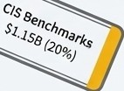

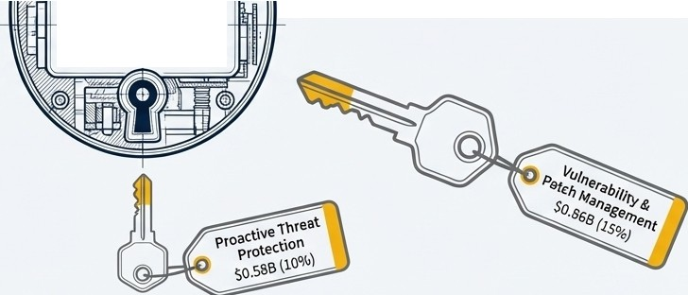

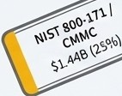
RLC-H Unlocks Five Interlocking Security Markets Totaling $5.76B
RLC-H:
The Turnkey Hardened Platform
These are not optional markets; they are mandatory requirements. RLC-H is uniquely positioned to serve all five segments with a single, integrated platform, a capabillity no competitor offers.

Slide 4
A Multi-faceted Opportunity Driven by Unavoideable Mandates
DISA STIG
Market Size $1.73B
Primary Driver DoD & Federal Mandates
RLC-H Positioning Pre-configured Enforcement
Market Growth 8-12% CAGR
NIST/CMMC
Market Size $1.44B
Primary Driver Defense Supply Chain Security
RLC-H Positioning 53% of Controls Addressed
Market Growth 15-20% CAGR
CIS Benchmarks
Market Size $1.15B
Primary Driver Commercial & Insurance Requirements
RLC-H Positioning Automated Level 1 & 2 Profiles
Market Growth 10-14% CAGR
Patch Management
Market Size $0.86B
Primary Driver Continuous Vulnerability Remediation
RLC-H Positioning FlPS-compliant 5-year LTS
Market Growth 9-12% CAGR
Proactive Protection
Market Size $0.58B
Primary Driver Defense-in-Depth Against Advanced Threats
RLC-H Positioning Unique LKRG Kernel-level Detection
Market Growth 12-18% CAGR

Slide 5


Segment 1: Securing the $1.73B DISA STIG Compliance Market
Market Definition: Required by all DoD systems, the 300,000+ companies in the Defense Industrial Base, and the Intelligence Community.
The Problem:Manual STIG implementation is the industry norm. It is slow, expensive (40-80 hours/server), and prone to configuration drift, creating continuous audit risk.
Manual Approach
RLC-H Automated Approach
----�--=>..)✓
x�
/-9
,......
-:- *
•
- '
-fl_,.
,ox
'l )
Ansible playbooks & custom scripts
Weeks to harden and validate
High risk of human error
Breaks on update
0 Pre-configured STIG enforcement by default
0 Audit-ready in hours, not weeks
0 Continuous monitoring for drift
0 Updates maintain STIG compliance
Key Customer: DoD prime contractors, federal systems integrators, and intelligence agencies.

Slide 6
Segment 2: The $1.44B CMMC Mandate - An Unprepared Market on a Deadline
The CMMC 2.0 rule (effective Nov 10, 2025) impacts 100,000+ defense contractors. Non-compliance means losing DoD contracts.
46%
Unprepared
Nearly half the defense supply chain is not ready for Level 2 certification,creating a massive, urgent demand for turnkey solutions.
53%
of Controls Addressed
RLC-H directly addresses 53% of the required technical NIST 800-171controls at the OS layer, dramatically accelerating assessment readiness.
$15K-$150K
Audit Cost
The high cost of third-party C3PAO audits drives demand for a "get it right the first time' platform that reduces remediation and
re-assessment costs.
RLC-H isn't just an OS; it's a CMMC acceleration engine, reducing audit scope, minimizing remediation findings (POAMs), and providing a faster path to certification.

Slide 7



Expanding the Front: From Commercial Compliance to Proactive Defense
CIS Benchmarks ($1.15B)
Vulnerability & Patch Management ($0.86B)
Proactive Threat Protection ($0.58B)
Who: Financial Services, Healthcare, Saas (PCI-DSS, HIPM, SOC2).
Driver: A requirement for 78% of cyber insurancepolicies.
RLC-H Edge: Pre-configured Level 1 & 2 profiles with automated scoring and audit-ready reporting.
Who: All large enterprises with compliance and uptime needs.
Driver: PCI-DSS mandates monthly patching; 38% of new CVEs are critical/high.
RLC-H Edge: 5-year Long-Term Support (LTS) with FlPS-validated
patches that preserve compliance state.
Who: High-valuetargets (government, finance, critical infrastructure).
Driver: Traditional EDR agents are user-space only and cannot protect the kernel from advanced threats.
RLC-HEdge: The only commercial distro with integrated LKRG (Linux Kernel Runtime Guard) for real-time exploit prevention.This is our unique, defensible moat.

Slide 8
The RLC-H Advantage: A Singular Platform vs. a Patchwork of Tools
Capability Area | Red Hat Enterprise Linux (RHEL) The Complex, Costly Incumbent | RLC-H (Our Advantage) The Integrated, Turnkey Solution
DISA STIG | Manual implementation using guides | Pre-configured & automated by default - Addresses 53% of controls out-of-the-box
NIST 800-171/CMMC | SCAP guide available, requires manual work
CIS Benchmarks | Manual implementation required | Level 1 & 2 profiles included Integrated & included in base subscription ,- LKRG kernel integrity & hardened_malloc (prevention)
Patch Management Proactive Protection | Requires expensive Satellite add-on SELinux only (detection)
Price | $1,299 - $2,499 per node | $775 - $1,000 per node (40-60% lower)

Slide 9
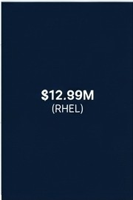

The Proof: Turning Months of Work and Millions in Cost into Real Savings
Large DoD Prime Contractor (Aerospace)
$14.99M
15M
$2.0M
�
(Manual Hardening Labor)
--- ⁰
--- ⁰
�())
?;t;
Current State: Manual hardening, custom scripts, Red Hat Satellite
<J)
C
=� 10M
---
0
$8.25M
�$=0---=:sM (Migration)
0
�·^{C}-
_J_
...,
<J)
0
()
Environment: 10,000 Linux Servers
Needs:
STIG, 800-171,
Patching, Proactive Protection
Ct)
SM
::,
C C
<(
$7.75M
(RLC·H Subscription)
OM'----
Current Annual Cost RLC-H Annual Cost
$6.74M Annual Savings (45% Reduction)
"RLC-H reduces audit preparation from months to weeks while providing a superior, continuously monitored security posture at nearly half the cost."

Slide 10
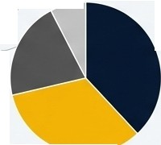
The Financial Blueprint: Scaling to a $576M Business
Metric | Year1 | Year2 | Year3
New Customers | 75 | 125 | 100
Total Customers | 75 | 200 | 300
Avg. Nodes/Customer | 2,000 | 2,500 | 2,800
Annual Revenue | $116M | $388M | $651M
Cumulative ARR | $116M | $504M | 57 111'1
Vear 1 Customer Acquisition Targets (75 Total)
Multi-Segment (Large Enterprise): 5 ---.-
Key Assumptions
Pricing at an effective ASP of ~$725/node 85% renewal rate
40% of revenue from channel partners by Year 3
CIS Benchmarks (Financial/Healthcare): 15
DISA STIG (DoD
,,,,,,---Contractors): 30
NIST/CMMC (Defense------�-� Supply Chain): 25
NIST/CMMC (Defense Supply Chain): 25

Slide 11









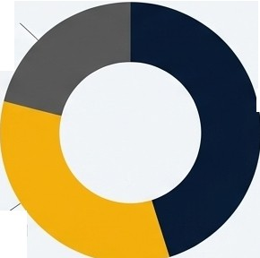
•
Fueling Our Growth: A $125M-$185M Investment for a 4.6x Return
-
•
over 3 years
Customer Success & Support: $25-40M
Sales& Marketing: $60-SSM
Building a specialized federal sales team (15-20 reps).
Activatingchannel partners (VARs, Sis,MSPs).
Driving demand with CMMC/STIG thought leadership.
Product &Engineering: $40-60M
Continued innovationin compliance automation (STIG, CIS,CMMC).
Achieving critical certifications(FedRAMP High, Common Criteria).
Expanding integrations(SIEMs, Scanners, Cloud).
Customer Success & Support: $25-40M
Scaling 24x7 premium support.
Building a professional services team for migration and implementation.
Ensuring an 85%+renewal rate through expert support.
Sales&Marketing:
- $60-SSM
Product& Engineering: $40-60M
Target:
$576MARR
ROI:
3-4.Gx

Slide 12
Why We Will Win: A Defensible Moat Built on Product, Timing, and Price
Unmatched Product Advantage
Turnkey Compliance: We eliminate weeks of manual work per server.
FIPS 140-3 Certified: A12-24 month competitive head start, crucial for federal contracts.
Unique Proactive Security: LKRG provides kernel-level protection no competitor offers.
Superior Economics
40-60% Lower TCO than RHEL: Our price advantage, combined with labor savings, creates an undeniable value proposition.
Perfect Market Timing
CMMC Enforcement (Nov 2025): Creates a market-wide, non-discretionary buying event.
FIPS 140-2 Sunset (Sep 2026):
Forces a technology refresh cycle across the federal
ecosystem.
Strong Foundation
Built on the trusted Rocky Linux base with millions of existing community deployments.

